Slide 1
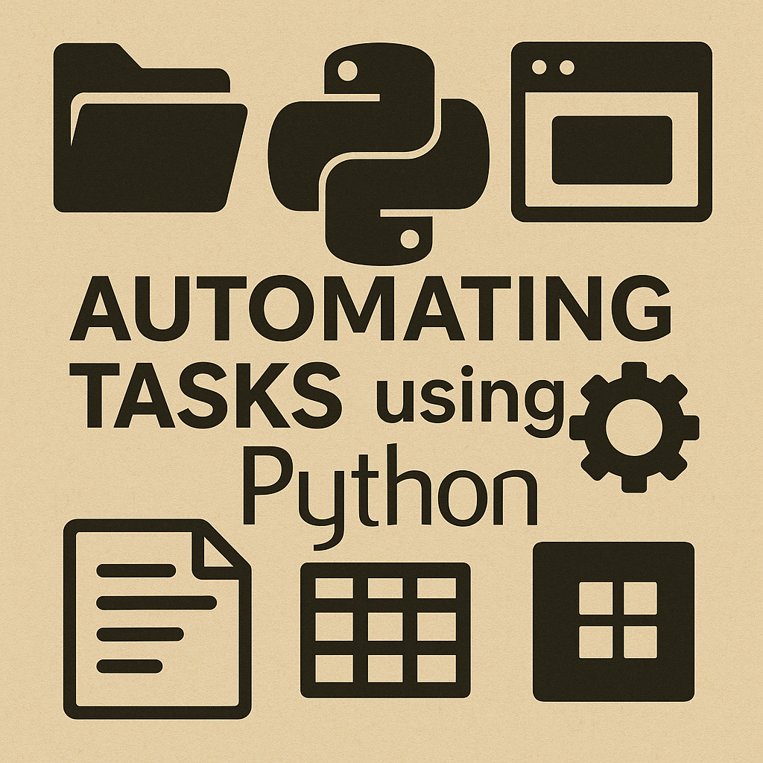

Slide 2

Valdis Saulespurens
Lecturer, Riga Technical University
Faculty of Computer Science, Information Technology and Energy
Course Materials: https://github.com/ValRCS/RTU_Automating_Tasks_With_Python

Slide 3
Course Overview
1. Getting Started with Python + VS Code
2. Working with Text Files & String Processing
3. Automating Excel with openpyxl
4. Data Processing with pandas
5. PDF Automation, Image Processing

Slide 4
Course Overview
6. Web Scraping (requests, BeautifulSoup)
7. Browser Automation with Selenium
8. Desktop GUI Automation with pyautogui
9. Email & File System Automation
10. Final End-to-End Automation Project

Slide 5
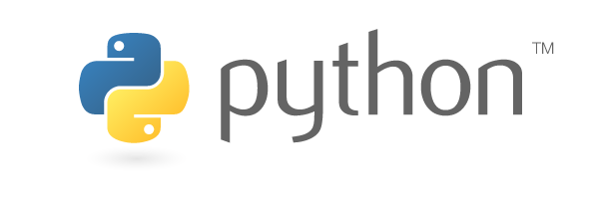
What We’ll Do Today
Why Python and short History
Install Python
Verify installation
Create .py files in Notepad
Install & configure VS Code
Run scripts
Basic Python
Mini automation teaser

Slide 6
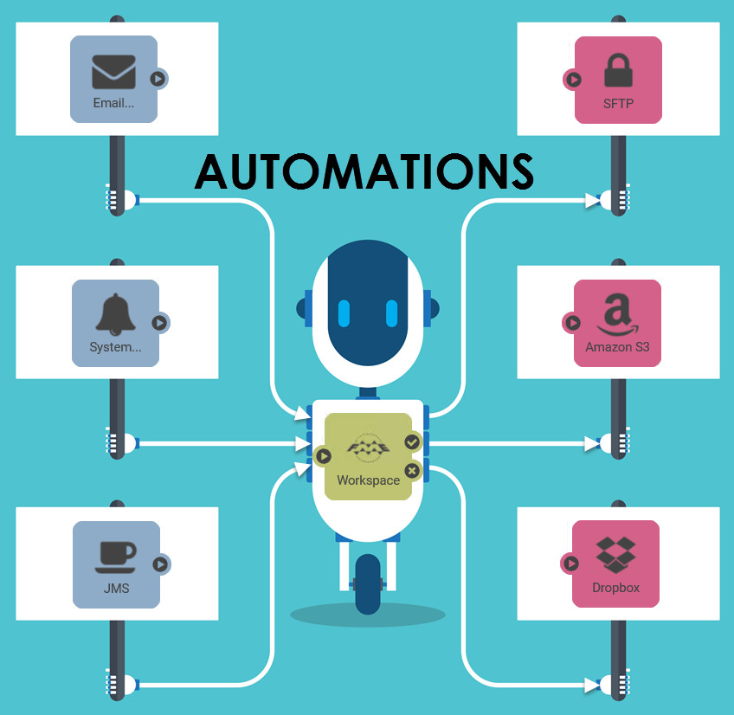
What Do We Mean by Automation?
Using software to perform tasks automatically instead of manually
Reducing repetitive work and minimizing human error
Saving time by letting the computer handle routine tasks
Standardizing processes for consistent and reliable results
Connecting systems together (files, apps, websites, APIs)
Triggering tasks automatically based on schedules or events
Scaling up tasks beyond what is feasible by hand
This Photo by Unknown Author is licensed under CC BY

Slide 7

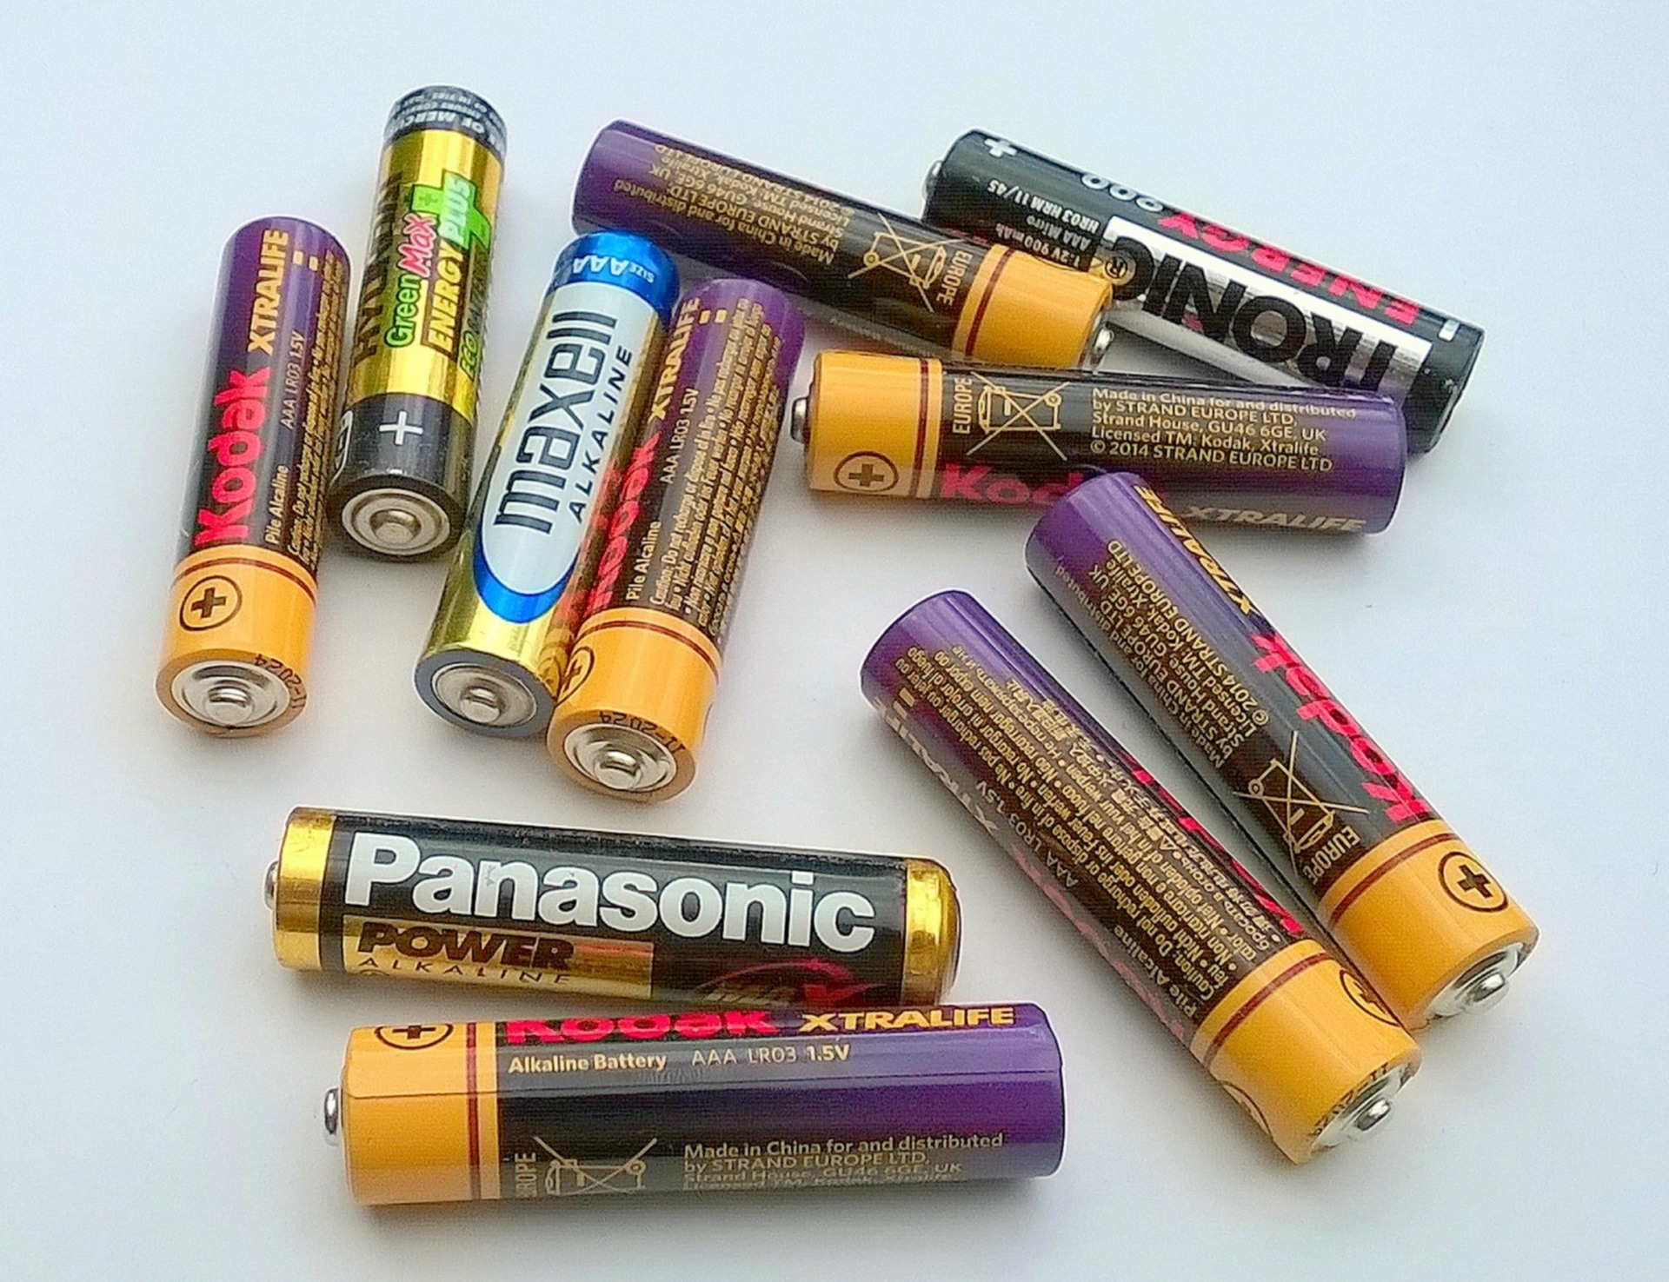
Why Python for Automation?
Simple & readable syntax → faster development and fewer bugs
Extremely popular with a huge community and long-term stability
Great 'glue language' for connecting files, APIs, tools, and services
Rich standard library ('batteries included') for common automation tasks
Powerful ecosystem: Excel, PDF, web scraping, GUI automation, and more
Cross-platform: works on Windows, macOS, and Linux
Excellent tooling: VS Code, Jupyter, virtual environments, pip
Fast prototyping: write useful scripts in minutes
Ideal for both beginners and experts

Slide 8




A Brief History of Python & Guido van Rossum
Created by Guido van Rossum in late 1980s at CWI (Netherlands)
First public release in 1991 (Python 0.9.0)
Designed for readability, simplicity, and a rich standard library
Python 2 released in 2000; Python 3 released in 2008
Python 2 officially retired in 2020 after long transition
Used today for automation, data science, AI/ML, web development, and more - #1 programming Language
Guido served as Python's BDFL until 2018
Now guided by the Python Steering Council (Guido still influential)
Guido worked at Google, then Dropbox then Microsoft
This Photo by Unknown Author is licensed under CC BY-SA
This Photo by Unknown Author is licensed under CC BY-SA-NC
This Photo by Unknown Author is licensed under CC BY
This Photo by Unknown Author is licensed under CC BY-SA

Slide 9
Installing Python
Download from https://python.org
Choose Windows Installer (64-bit) (unless on MacOs or ARM tablet)
Get Last Years Latest Version (3.13.9 in 2025)
Check 'Add Python to PATH'
Use recommended settings

Slide 10
Verify Python Installation
Run in CMD:
python --version
python

Slide 11
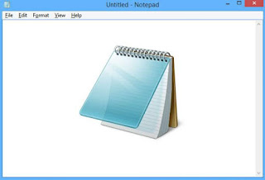
Python is Just Text
Use any editor (even Notepad)
Example:
print("Welcome to Python automation")
Save as hello.py
Run: python hello.py
This Photo by Unknown Author is licensed under CC BY-SA-NC

Slide 12
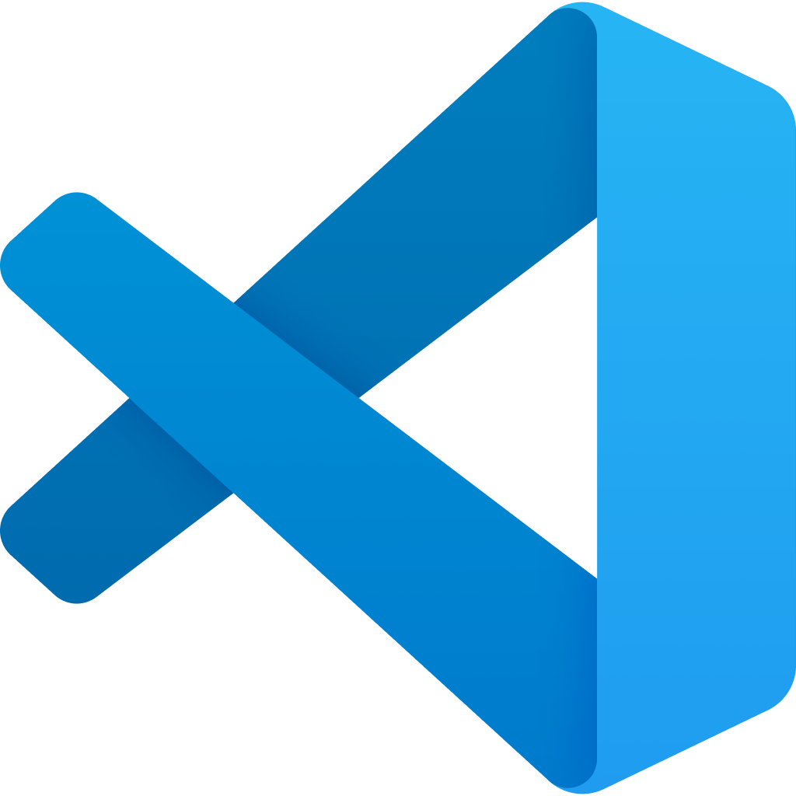
Installing Visual Studio Code
Download from code.visualstudio.com
Standard install
Cross-platform

Slide 13
Essential VS Code Extensions
Python – REQUIRED https://marketplace.visualstudio.com/items?itemName=ms-python.python
Pylance
Jupyter
Black
isort
Optional: PowerShell, WSL

Slide 14
Setting Up Your Workspace
Create
Create folder: python_automation_day1
Open
Open folder in VS Code
Select
Select Python interpreter

Slide 15
VS Code Shortcuts
Ctrl+Shift+P – Command Palette
Ctrl+` – Terminal
Ctrl+F5 – Run
Ctrl+P – File search
Ctrl+Shift+F – Search Text in project
Many more – can customize!
https://code.visualstudio.com/docs/reference/default-keybindings

Slide 16
First Script in VS Code
Create hello.py
print("Hello, world!")
Run with Run button or terminal

Slide 17
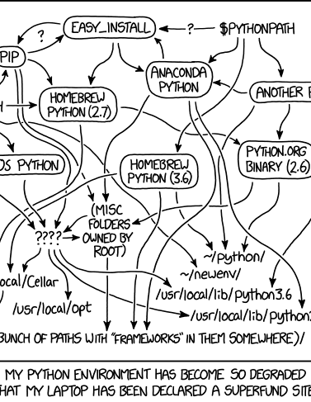
Virtual Environments (Optional)
python -m venv venv
venv\Scripts\activate
Official Python venv tutorial: https://docs.python.org/3/tutorial/venv.html
Real Python – Virtual Environments Primer: https://realpython.com/python-virtual-environments-a-primer/
VS Code – Working with Python Environments: https://code.visualstudio.com/docs/python/environments
https://xkcd.com/1987/

Slide 18
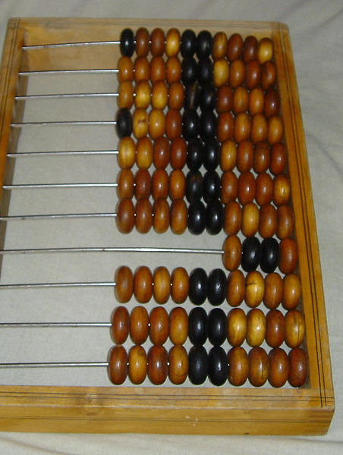
Python Arithmetic
3 + 2
7 - 3
4 * 5
8 / 2
20 % 7
2 ** 3
BIG NUMBER SUPPORT
This Photo by Unknown Author is licensed under CC BY-SA-NC

Slide 19
Python Variables
a = 10
b = 5
print(a + b)
Dynamic typing

Slide 20

Python Errors
SyntaxError
IndentationError
NameError
Errors = Feedback

Slide 21
Mini Automation Teaser
name = input('Enter your name: ')
print('Hello,', name)

Slide 22
Potato Program
We want for user to input their favorite food
We want to ask for its price
We want to find out how much to buy
We want to calculate total
What to improve?

Slide 23
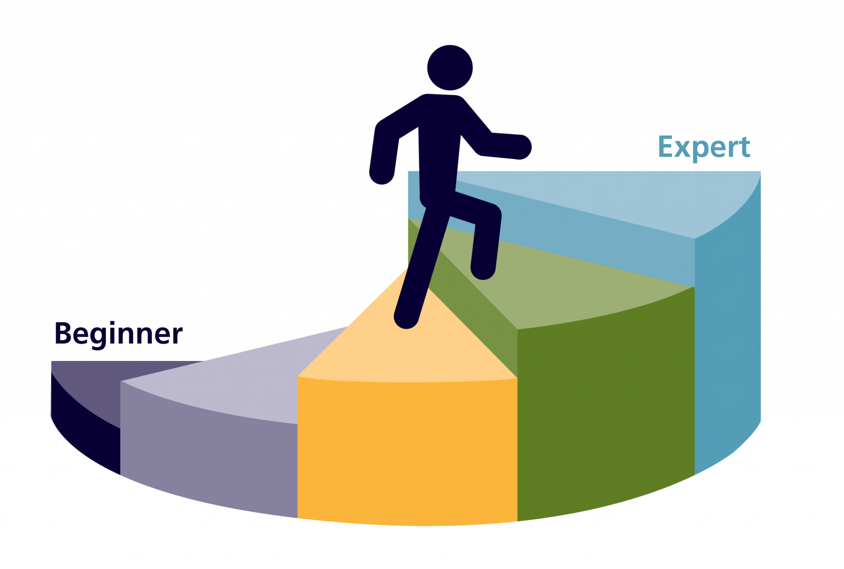
Beginner-Friendly Python Resources
Official Python Tutorial: https://docs.python.org/3/tutorial/
Automate the Boring Stuff (free online): https://automatetheboringstuff.com/
Real Python Tutorials: https://realpython.com/
W3Schools Python Basics: https://www.w3schools.com/python/
Google Python Class (free): https://developers.google.com/edu/python/
Python Cheatsheet: https://www.pythoncheatsheet.org/
VS Code Python Tutorial: https://code.visualstudio.com/docs/python/python-tutorial
This Photo by Unknown Author is licensed under CC BY-SA

Slide 24
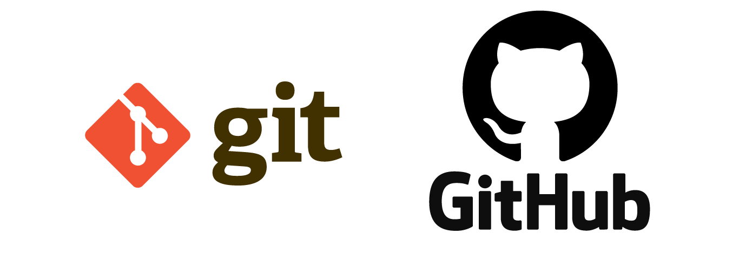
Not Covered in this Course but Very Useful: Git & GitHub
Git = version control for tracking changes in code
GitHub = platform for storing and collaborating on code
Helps back up scripts and sync work between computers
Track history, undo mistakes, compare versions
Essential for teamwork and professional development
Beginner Resources:
• Download Git: https://git-scm.com/downloads
• GitHub Getting Started Guide: https://docs.github.com/en/get-started
• VS Code + Git Basics: https://code.visualstudio.com/docs/sourcecontrol/overview
This Photo by Unknown Author is licensed under CC BY-SA

Slide 25

What We Learned Today (Day 1)
What automation means and why it's useful
What Python is and how it came to be
Python installation on Windows (with PATH)
Installing and configuring VS Code
VS Code essentials: Python extensions
Creating and running Python scripts (.py)
Running simple code: print, variables, basic arithmetic
Overview of the full 10-part course structure
Beginner resources (virtual environments, Git/GitHub)

Slide 26
What’s Next
Text processing
Reading & writing files
Homework: write TINY scripts

